Slide 1



Up-Skilling program ICTC5
Web Development
Ministry of Social Development
Soft Skills: | English Language: | Technical Skills
Dr.William Smairat | Ms.Jacquelyn Brown | Dr.Jalal Kiswani Ms.Hana Alrasheed

Slide 2


Agenda
Project Idea
Processes
Design
Sitemap………
...
Wireframe
Mockup….
Prototype..
Development
Database
Conclusion

Slide 3

Project Idea
Why Ministry of Social Development ?
Remodeling for Ministry of Social Development website.
Add important information to website content.
Add new services:
1- Social assistance request service.
2- Issuing disability card service.
3- Complaints and suggestions service.

Slide 4

Processes
Select one website from 10 websites.
Prepare the contents of website.
Build the Sitemap of site.
Design Wireframe.
Design Mockup.
Prototyping.
Build ERD and tables in Database.
Developing.
Testing.

Slide 5

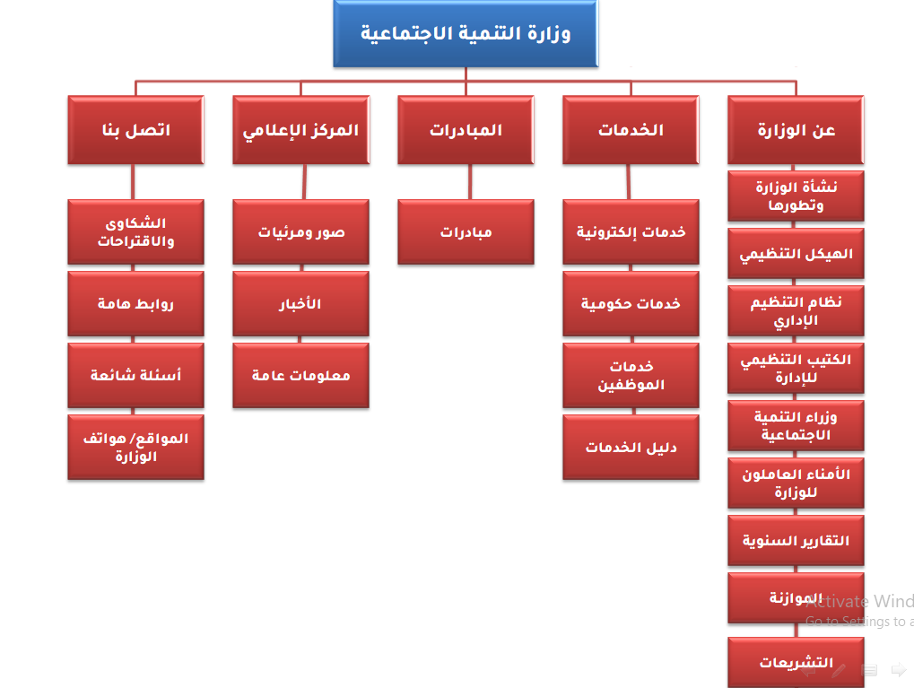
Design
Sitemap
Fig1_Sitemap: is a list of the website pages showing their links to each other

Slide 6
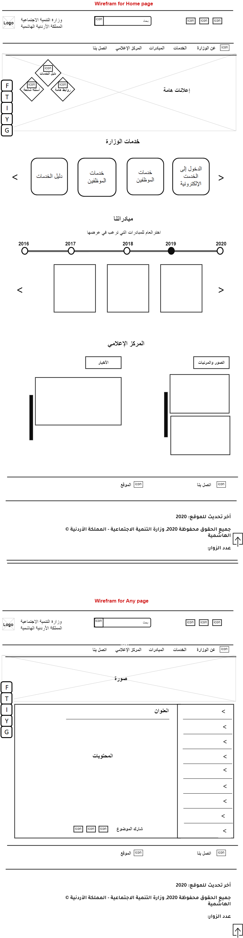
Wireframes
[1]
[2]
Fig2_ Wireframe : is a visual guide that represents the skeletal framework of a website.

Slide 7
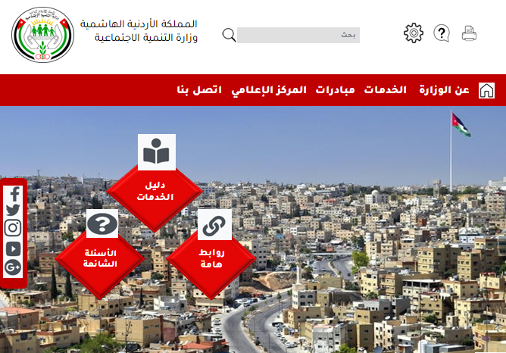

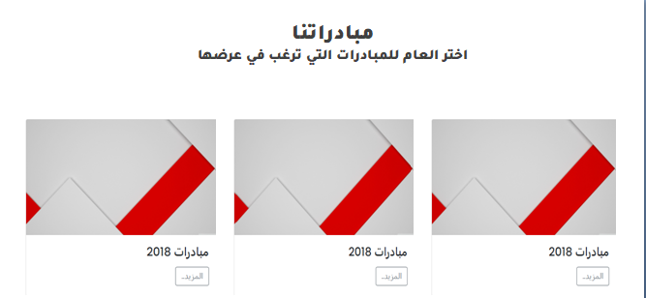
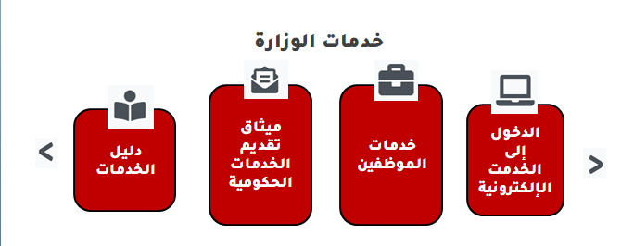
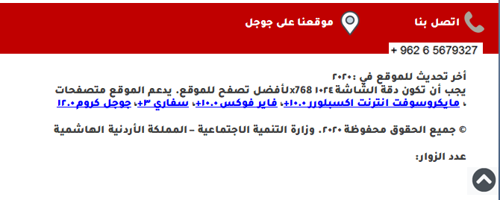
Mockups
[1]
[2]
Fig3_ Mockup: is a prototype if it provides at least part of the functionality of a system and enables testing of a design.

Slide 8
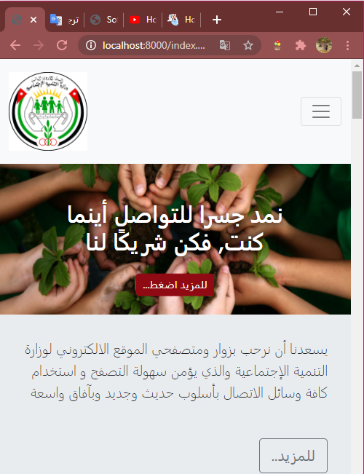
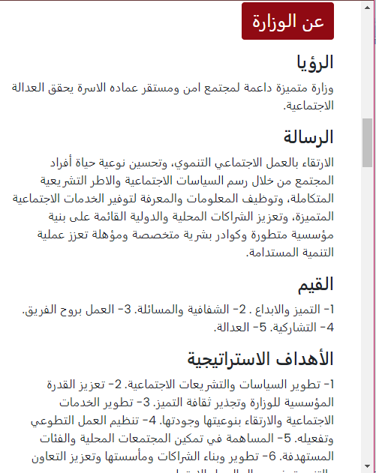

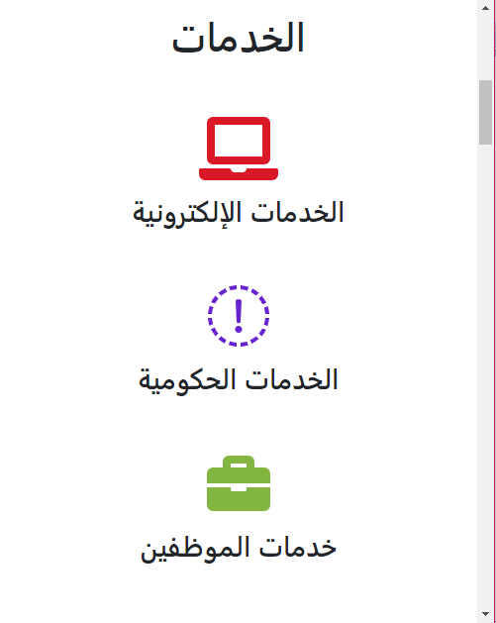
Prototypes
[1]
[2]

Slide 9
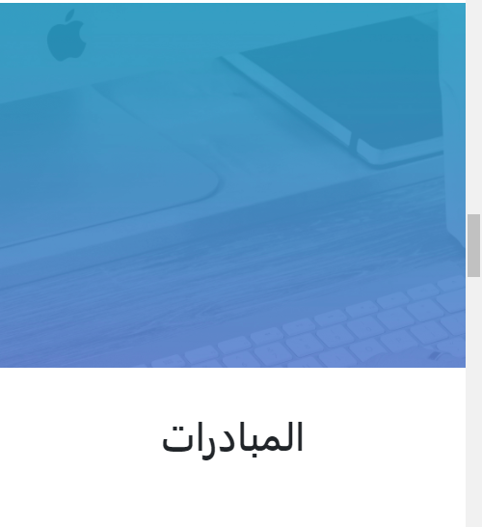
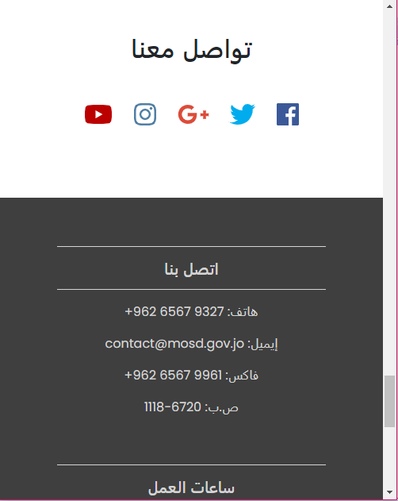
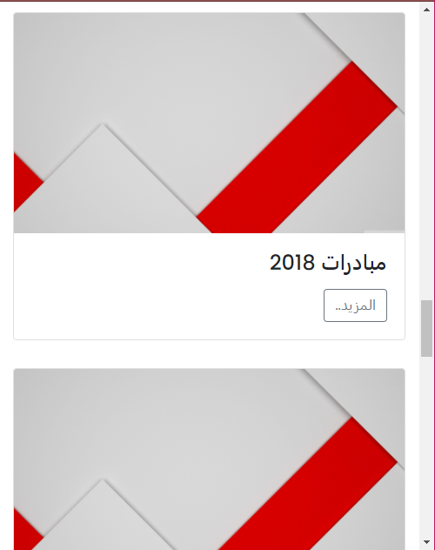
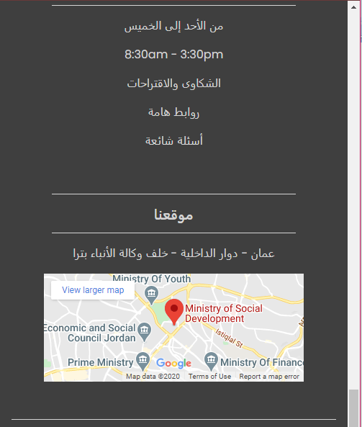
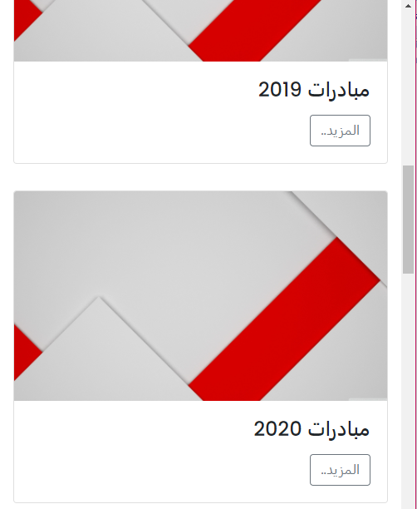
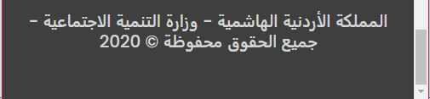
[3]
[4]
Fig4_ Prototype: model.

Slide 10
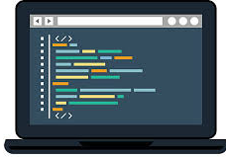
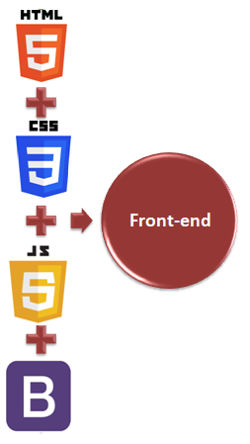
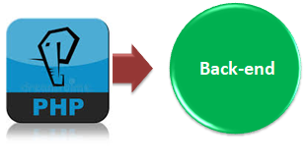
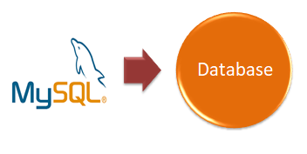
Development
Fig5_ Tech: Technologies that used.

Slide 11

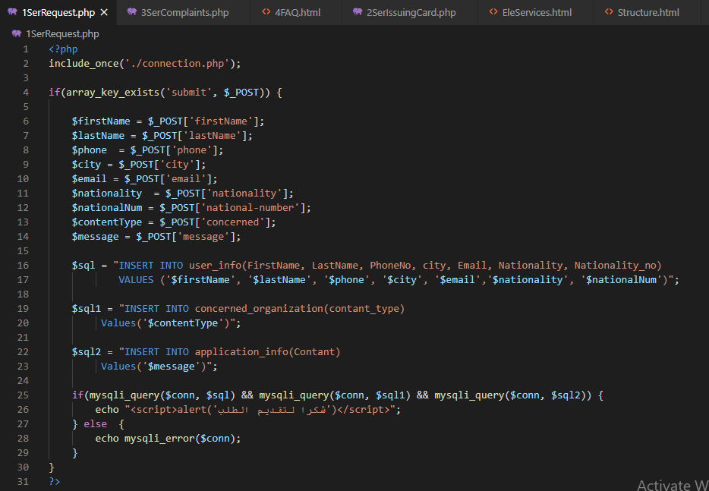
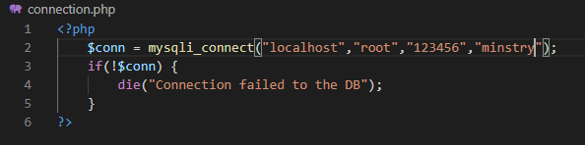
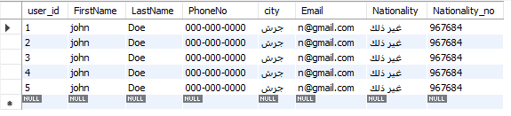
Database
Fig6_ Database: Connection and php code.

Slide 12

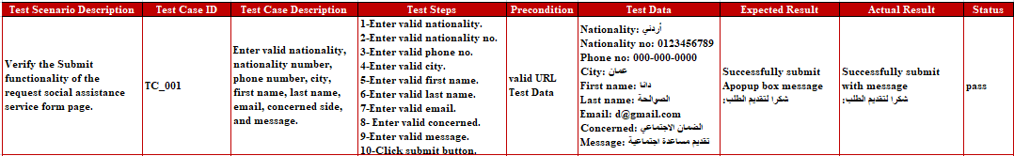
Testing
Fig7_ Testing: one of test cases.

Slide 13

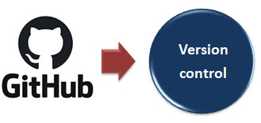
Conclusion
Modern and functional website.
User friendly Interface.
Responsive website.
New services.
Saving time and effort.
Informative website.
Note: All work uploaded on GitHub.

Slide 14

References
1. https://en.wikipedia.org/wiki/Site_map
2.https://en.wikipedia.org/wiki/Website_wireframe#:~:text=A%20website%20wireframe%2C%20also%20known,best%20accomplish%20a%20particular%20purpose.&text=Wireframes%20focus%20on%3A,The%20range%20of%20functions%20available
3.https://en.wikipedia.org/wiki/Mockup#:~:text=In%20manufacturing%20and%20design%2C%20a,enables%20testing%20of%20a%20design
4.https://en.wikipedia.org/wiki/Prototype#:~:text=A%20prototype%20is%20an%20early,test%20a%20concept%20or%20process.&text=A%20prototype%20is%20generally%20used,rather%20than%20a%20theoretical%20one.

Slide 15


Thanks
Upskilling program ICTC5-Web Development
Date: Oct. 20th, 2020
Name: Dana Alsawalha

